Slide 1
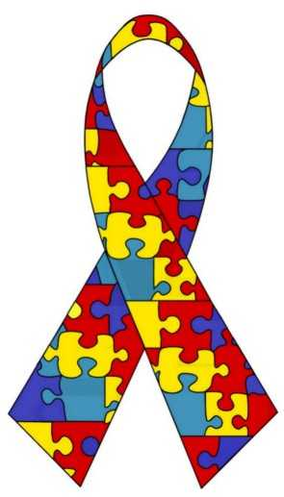
Autism
By Emily Ramos

Slide 2
What is Autism?
Autism is a complex, developmental disability that is defined by 3 areas of significant impairment:
social interaction
communication
restricted and repetitive behaviors, interests, and activities.
To have autism a child must show impairment in all 3 areas (2 from social, 1 from communication, and 1 from restricted and repetitive behaviors & interests)
The child must show these delays before age 3.
There are currently more than 1.5 million people with autism in the united states.

Slide 3
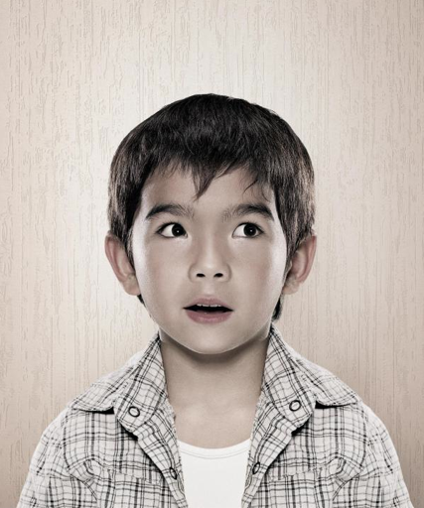
Social impairment
Nonverbal skills- eye contact, body posture, facial expressions.
Peer relationships- not age appropriate.
Lack of spontaneous seeking to share interest with others (joint attention)- no showing or pointing out objects of interest to others.
Lack of social and emotional reciprocity, which means the give and take in a relationship-lack of empathy, doesn’t know what others are thinking
Only two of these four symptoms are required to make a diagnosis.
Remember: A child may not show all of these symptoms and still have autism

Slide 4
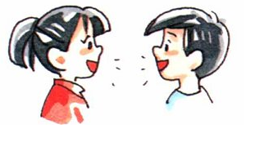
Communication impairment
Delay or lack of language
Poor conversational skills
Idiosyncratic language- repetitive or scripted speech, including echolalia (repeating words or statements)
Lack of pretend play
One of these symptoms is required

Slide 5
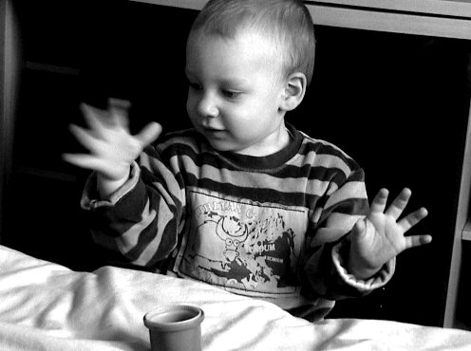
Restricted and Repetitive Behaviors, interests, and activities
Overly preoccupied with specific areas of interest.
Inflexible to change in routines or rituals.
Stereotyped and repetitive motor mannerisms- hand flapping, finger twisting, rocking, etc.
Persistent preoccupation with parts of objects.
One of these symptoms is required to make the diagnosis.

Slide 6
Autism is presently considered one of the many Pervasive Developmental Disorders, which include Asperger’s Syndrome, PDD-NOS, Rett Syndrome and Childhood Disintegration Disorder
Autism is being reclassified as part of a single Autism spectrum disorder which will include only Autism, PDD-NOS, and Asperger’s Syndrome under one category with disabilities ranging from severe to mild, according to DSM-V (Diagnostic Statistic Manuel) in 2013.
Presently people use the term Autism Spectrum Disorder to refer to Autism, PDD-NOS, and Aspergers, even though it is not formally recognized yet.

Slide 7
Aspergers
It is a form of high functioning autism
No language impairment
High cognitive ability- IQ from average to gifted
Must have a narrow area of interest or an obsession (popular obsessions include trains, weather, and historical dates)
Despite their intellectual advancements, they often have gaps in learning
Some behaviors: Rigidity, black & white thinking, perseverating, anxiety, poor social skills, and preference for sameness.
Clumsy and uncoordinated

Slide 8
PDD-NOS
Pervasive Developmental Disorder Not Otherwise Specified.
This diagnosis is used when a child does not meet the criteria for autism or Aspergers, but still displays some symptoms.
It is considered “atypical autism” because of
late age of onset- after the age of 3
atypical symptoms- example: very social, but inappropriate.
sub threshold symptoms (fewer number of symptoms, but still impaired)

Slide 10
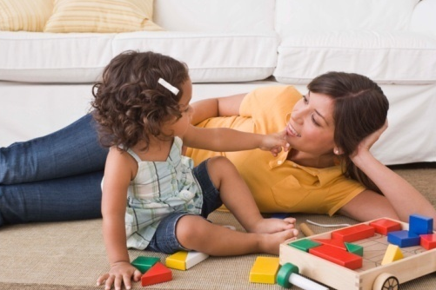
Signs And Symptoms (Red Flags)
No social smile by 2-3 months of age.
No notice when caregivers leave or enter the room by 6-9 months of age.
No pointing or babbling by 9 months or later.
Not responding to name when called.
Lacking back and forth play with teachers, caregivers, or other children.
Has odd movement patterns
Has language delays
Gets stuck on things over and over.
Lack of Pretend play
Poor eye contact

Slide 11
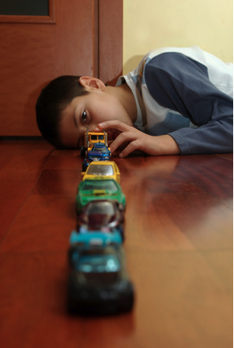
Signs and Symptoms continued….
Prefers to play alone
Not interested in other children and/or not knowing how to play with them.
Walks on his or her toes
In his/her “own world”
Inappropriate play: Lines up toys, unusual attachments, and prefers spinning objects.
Echolalia
Gives unrelated answers to questions
It is important to remember that children in the autism spectrum may not show all of these symptoms.

Slide 13
Myths
Nature vs. Nurture: Autism was once thought to be caused by bad parenting, but now we know it is a neuro-biological disorder.
All individuals with Autism are retarded: Abilities can range from very impaired to genius.
People with Autism can not have relationships or show affection: Not all people with Autism prefer to be alone, and some are extremely social.
Autistic people have no language skills: There is a range of impairment in language skills from non verbal to highly verbal.
The divorce rate in families with autism is 80%: Children with autism remain with both their parents 64% of the time, compared to children without autism that remain with both their parents 65% of the time.

Slide 14
History
First described by Dr. Leo Kanner, in 1943
In his original description he observed a group of young children who all had social detachment, delays in language, and the need for sameness.
Early on people thought it was a form of schizophrenia
Based on the work of Kanner, Bruno Bettelheim theorized that inadequate parenting by “refrigerator mothers” caused Autism.
We now know this is not true.

Slide 15
History continued….
In 1944 Dr. Hans Asperger published a paper describing children with the same characteristics as Kanner described, but it remained an obscurity for decades until was rediscovered by a British psychologist, Lorna Wing.
Unlike the children described by Kanner, those described by Asperger had intact speech, although were socially inappropriate and odd.
They were socially aloof and had narrow areas of interest
Interesting Fact: Neither were aware of each other’s work.
Official recognition of Autism as a diagnosis was not until 1980 in the DSM-III.

Slide 16
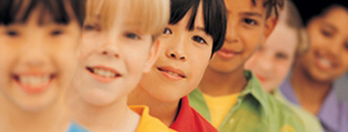
Prevalence
The CDC estimates an average of 1 in 110 children are diagnosed with Autism
Ratio of males to females is 4 to 1, possibly due to an x-linked gene defect, but it is not fully proven.
Current studies show a dramatic increase in the last 50 years due to many different factors: a broadened definition of Autism (Aspergers and PDD-NOS), an actual increase in numbers, and diagnostic substitution (calling more things Autism).

Slide 18
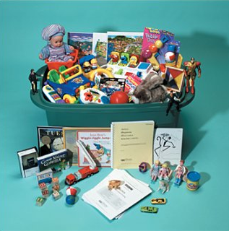
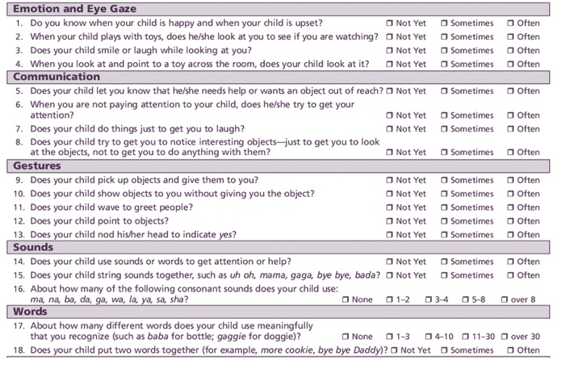
Steps in Diagnosis
1. History
2. Observation
3. Tests

Slide 19
Clinical History
Birth history (premature)
Developmental milestones (language, motor skills, etc.)
Past medical and surgical history (infection, illness, trauma, etc.)
Family history
Immunization history
Appetite and sleep
Behavioral history (descriptions of odd or unusual behaviors.)
School history

Slide 20
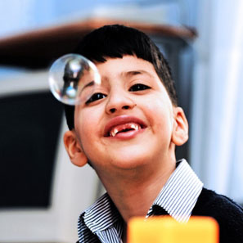
Observation
Social interaction
Play skills
Language
Motor development (ex. Toe walking, coordination deficits)
Unusual and repetitive behaviors (flapping, spinning, rocking, etc.)
Obsessive interests (Common obsession: trains, dinosaurs, lights, fans, and letters)
Interesting fact: People with Autism usually have a larger head circumference and larger brain volume.

Slide 21
Tests
Hearing test
Lab Tests: MRI of brain, EEG (to detect seizures), Chromosomes (genetic disorders)
Specific tests: ADOS- Autism Diagnostic Observation Schedule, MCHAT- Modified Checklist for Autism in Toddlers, CARS- Childhood Autism Rating Scale
Parent and teacher reports and checklists: SRS- Social Responsiveness Scale, SCQ: Social Communication Questionnaire.

Slide 22
New Tests
Chromosomal microarray analysis- a test to see small changes in genes that may contribute to Autism.
Certain genes are highly associated with autism such as different locations on chromosome 15, 16, and 17
EEG to diagnose Autism (in 6-24 months of age). Children with autism had different brain wave patterns. The study was conducted at Boston Children’s Hospital. They had 80% accuracy on predicting Autism in children of 9 months of age.
Functional MRI showing specific blood flow patterns in the brains of children with autism.

Slide 23
Associated Conditions
Seizures
Specific genetic disorders (tuberous sclerosis, Angelman’s syndrome, and Fragile X are the most common)
Mental retardation (25-75%)
Self-injurious behaviors (such as biting, hitting oneself, and head banging.)
Sensory and perceptual problems- hearing, vision, touch, smell, and taste sensitivities.
Savant skills- music, art, and numbers
Prevalence of savant abilities in autism is 10%
The reason for these abilities is unknown.

Slide 24
Derek Paravicini

Slide 25
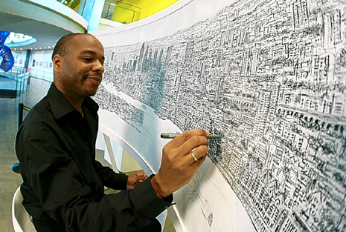
Stephen Wiltshire
Known as “the human camera”
He is able to draw a whole city from memory after only one helicopter ride.

Slide 26
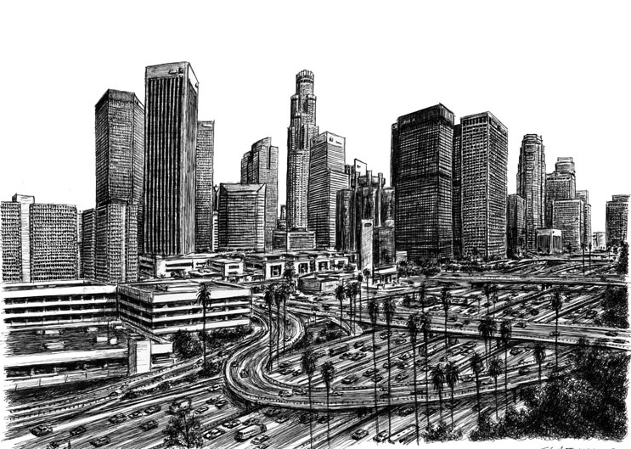

Slide 27
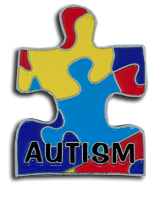
There is not one cause of Autism
In 1963 the National Autistic Society in England created the colorful puzzle piece as a symbol of autism to represent the mystery and complexity of autism. Also the bright colors represent hope.
Genetics
Most researchers agree some cases of Autism result from a genetic predisposition and an unknown environmental trigger.
Specific syndromes associated with autism (Such as Fragile X, Tuberous Sclerosis, Congenital Rubella, Neurofibromatosis)
Twin studies- there is a high concordance rate (30-60%)in identical twins with autism.
Higher risk of autism in males (4 to 1) pointing to a defect in the X chromosome.

Slide 28
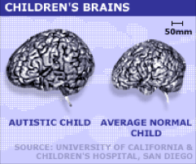
The Brain
Brain overgrowth in the first 2 years of life (children with Autism generally have larger heads.)
Microscopic brain abnormalities:
fewer Purkinje cells (a type of neuron in the cerebellum)
cells in the limbic system are smaller and more tightly packed together
Abnormalities in the size and densities of neurons.
Dysregulation of serotonin and possibly other hormones that regulate mood.
Mitochondrial defects are linked to Autism

Slide 29
Possible environmental triggers
Prenatal - Intrauterine infection, anti-brain antibodies
Parental Age- older fathers
Infections:
viral, bacterial, or fungal infections in children and pregnant mothers.
In some children with Autism, there is a family history of autoimmune diseases such as diabetes and rheumatoid arthritis, and celiac disease.
Toxins- a theory that environmental toxins may be a trigger for Autism.

Slide 30
Controversial theories
Vaccines are still being explored as a cause of autism, but currently there is no conclusive data.
Thimerosal (a mercury containing preservative used in vaccines.)
There is no conclusive data but thimerosal was taken out of most vaccines in 1999.
The Gut-Brain theory:
proposes that damage to the intestinal lining caused by antibiotics and other factors allows substances to leak out and affect the brain.
This has lead to parents using special diets such as the Casein free, gluten free diet (no dairy or wheat), and although there is no proof, many parents have claimed it helps.
Detoxification impairment and oxidative stress (kills cells)
Glutathione is used as a supplement to repair detoxification processes and as an antioxidant.

Slide 31
Treatments
There are four basic categories of treatment:
Behavioral
Educational
Therapy
Pharmaceutical

Slide 32
Behavioral & Educational
Early intensive behavioral therapy such as ABA (Applied Behavioral Analysis), TEACCH, and others.
Social skills training- Examples of specific programs: Social Stories, and Peer training.
Play or interaction focused interventions (floor time)- done at home with the parents.
Cognitive therapy for higher functioning individuals.
Specialized classrooms (Autism clusters)
Specialized teaching methods: PECS (picture exchange communication system- using pictures to facilitate language).
Specialized schools.

Slide 33
Therapy
Speech- language development
Occupational- fine motor difficulties
Physical- gross motor/ large muscle problems
Music- for relaxation and stimulation
Sensory integration- a specialized form of occupational therapy to address sensory sensitivities (noises, smells, textures) and to calm high arousal states.

Slide 34
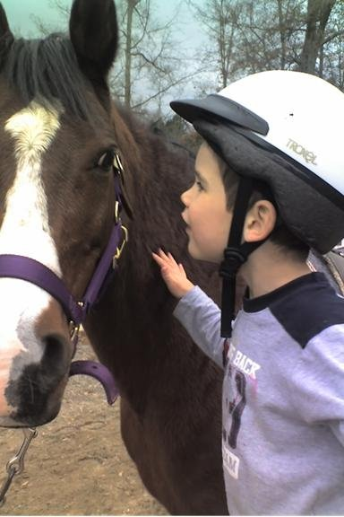
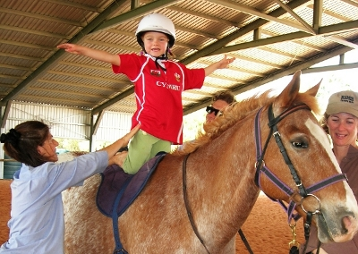
Hippotherapy
Therapeutic riding of horses ( In Greek hippos means horse)
Useful for gaining a sense of body-awareness, increased balance, improving communication, socialization, fine motor coordination, and bonding with the horse.
They usually ride without a saddle because the movement of the horse is suppose to make the child aware of their own body because children with autism often have coordination problems.
The bond between horse and child encourages emotional attachment which hopefully will be expanded to include family members and friends.
People are now using therapy with other animals such as dolphins and dogs.

Slide 35
Pharmaceutical Treatments
Medications to affect problem behaviors:
ADHD medications (Ritalin & Adderall)
Mood stabilizers (Depakote & Trileptal)
Atypical anti-psychotics (Risperdal & Abilify) to help aggressive and self-injurious behavior.
Anti-anxiety and antidepressants (Zoloft & Prozac).

Slide 36
Controversial & Unproven Treatments
Hyperbaric oxygen chambers
Chelation therapy- removing heavy metals from the blood.
Stem cell transplants
Hormonal supplements
IVIG (Intravenous immunoglobulin)- to boost immune system
Vitamin B-12 shots- thought to improve the absorption of nutrients
Specialized diets- yeast free, sugar free, soy free, etc.
Probiotics (for Gut-brain theory).
Omega3 fatty acids for brain development.
Some of these may be harmful

Slide 37
Important Variables Affecting Prognosis
Level of language
Cognitive skills
Self help skills
Adaptive vs. maladaptive behaviors- Being able to cope with situations in life.
Associated medical conditions- seizures (25% of kids with Autism have seizures) or syndromes.
Family structure
Socio-economic stress

Slide 38
Public Supports
Qualify for ESE services in school.
Public school services end at the age of 22.
Supplemental Security Income (monthly checks)
Respite care through state agencies.
The cost of Autism over a lifespan is 3.2 million dollars per person
State laws requiring insurance companies to pay for autism services vary by state. Many were passed in 2008 and 2009.
Florida: the Geller act requires insurance companies and Medicaid to pay for autism services.

Slide 39
What about autism in adults?
Current estimates of the number of autistic adults are uncertain. The NARPAA cites that more than 600,000 adults have autism (in 2008)
80% of the current individuals with autism are under 22 years old.
Most adults with autism continued to live with parents, siblings, or other relatives.
A majority are unemployed.
There are few government funded resources for adults
In 2009 the Advancing Futures for Adults with Autism was created
The main needs for adults with autism are housing, transportation, and employment.

Slide 40
Affect on the family
Siblings may feel neglected because of all the attention on the affected child.
Isolation- Severely Autistic people may not be able to leave the house.
Recurrence risk- fear of having more affected children.
Guilt-Parents feel guilty because the cause is unknown.
Safety- The Autistic child may need constant supervision.

Slide 41
Autism organizations, Advocacy Groups, and resources
Autism speaks
Autism Society of America
State funded autism centers: example in Florida- CARD center
ASAT- association for science and autism treatment
OAR- organization for autism research
All of these groups fund research and education about Autism and related disorders.

Slide 42
What we don’t know…..
How do genetic and environmental triggers exactly lead to autism?
Are there unknown factors that worsen or improve Autism?
What is going to happen when the growing number of children with autism become adults?
Is there anything we can do to prevent Autism?

Slide 43
“ What would happen if the autism gene was eliminated from the gene pool? You would have a bunch of people standing around in a cave, chatting and socializing and not getting anything done.” ~ Temple Grandin

Slide 44
Bouba or Kiki?

Slide 45
Two psychologists, Ramachandran and Hubbard, suggest that the bouba/kiki effect has implications for the evolution of language, because it suggests that the naming of objects is not completely arbitrary. The rounded shape may most commonly be named "bouba" because the mouth makes a rounded shape to produce that sound while a more taut, angular mouth shape is needed to make the sound "kiki”
90% of typical people agree that bouba is the rounded one and kiki is the angular one
Only 60% of people with Autism agree on this
This was studied across many cultures and languages to learn more about communication.
It shows that language is more complex than just learning words.
It may help to understand communication difficulties in autism.

